Slide 1

SOLEY FOR THE PURPOSES OF FORAGE WORK EXPERIENCE
A Data-Driven Approach to Enhance Booking Conversion Rates

Slide 2
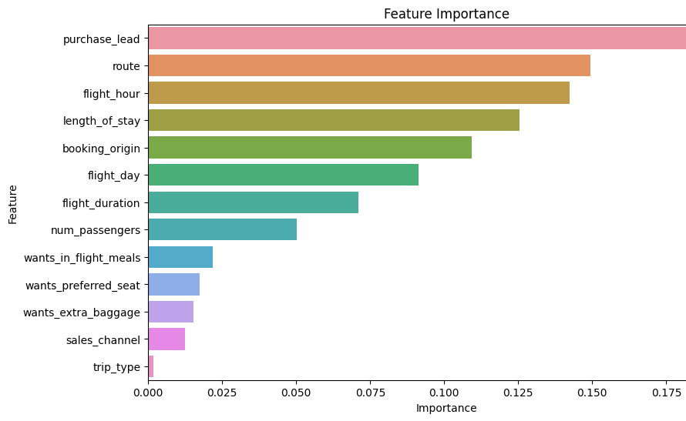
Predictive Model for Customer Booking Behaviour
Objective : To build a model that accurately predicts whether a customer will complete a booking, enabling smarter marketing and operational strategies.
ACCURACY SCORE : 85.62%
CROSS-VALIDATION SCORE(MEAN) : 49%
Top 3 features are : purchase lead, route, flight hour
📌 Business Impact
Enables focused marketing strategies on high-impact features.
Supports personalized offerings based on top predictors like route and purchase lead time.

